Slide 1
Big Mountain Data Analysis
Andrew Bryan

Slide 2
AGENDA
Problem Statement
Key Findings and Recommendations
​Modeling Results and Analysis
​Summary​

Slide 3
Problem Statement
In the past, Big Mountain Resort has charged above market price for their tickets. However, there is a worry that without a data-driven approach to ticket pricing, Big Mountain might be losing out on some profit margin.
Can Big Mountain Resort increase profitability of their ticket sales by 10% before the season begins by either developing park improvements or by reducing maintenance costs by closing ski lifts/ski runs?

Slide 4
Findings and Recommendation

Slide 5



Key Findings
Early scatter plots identified that there are general trends between ticket price and the following features: vertical drop, total number of chairs, total number of runs, snow making area, and number of fast quads
A forest model was applied to the data. The data provided was used to train the model, which indicated that the features with the most importance to ticket price are number of fast quads, total number of runs, snow making area, and vertical drop.
The model also indicated that Big Mountain could charge up to $95.87 per ticket without making any changes at all (An increase of $14.87 per ticket).
Scenarios were ran against the model using shortlisted changes that had been pre identified by the leadership team. Based on those findings the following are the recommendations for Big Mountain:
Reduce Runs
Remove the least popular run on the mountain; this does not decrease the models recommendation for ticket price.
Remove the five least popular runs on the mountain; this will only decrease the models recommendation for ticket price by $0.70. This will ideally reduce maintenance costs enough that with the same ticket price, Big Mountain will be making higher profits.
expand
The model identified that increasing the number of runs, the total vertical drop, and total number of chairs has positive impacts on the recommended ticket price.
A scenario of increasing each by 1, 150, and 1 respectively recommends an increase of $1.99 in ticket price. Therefore, focusing on enhancing the park will lead to higher ticket prices and ultimately higher profits.

Slide 6
Modeling Results

Slide 7
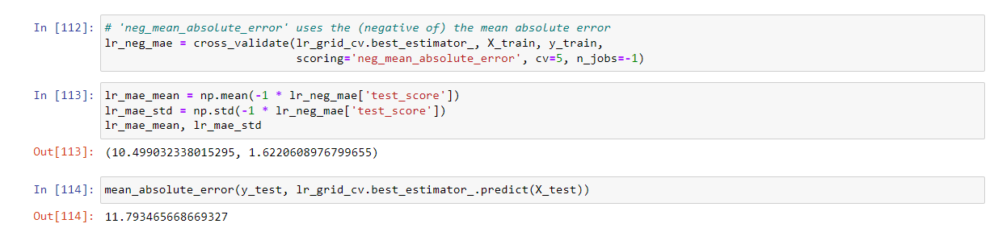
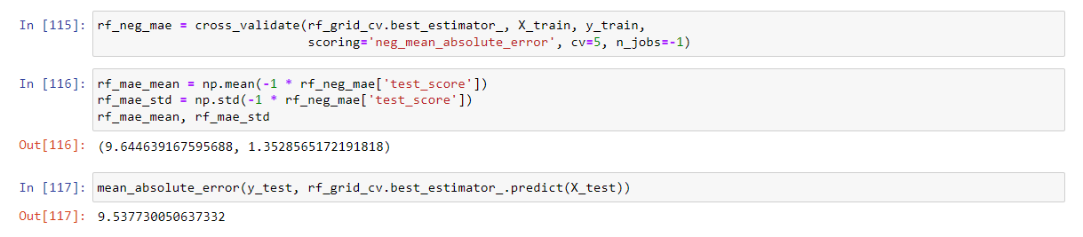
Linear Regression Model Testing
Random Forest Model Testing
The random forest model produced testing results which showed a lower cross-validation mean absolute error by almost $1 and less variability, therefore it was the model chosen.

Slide 8
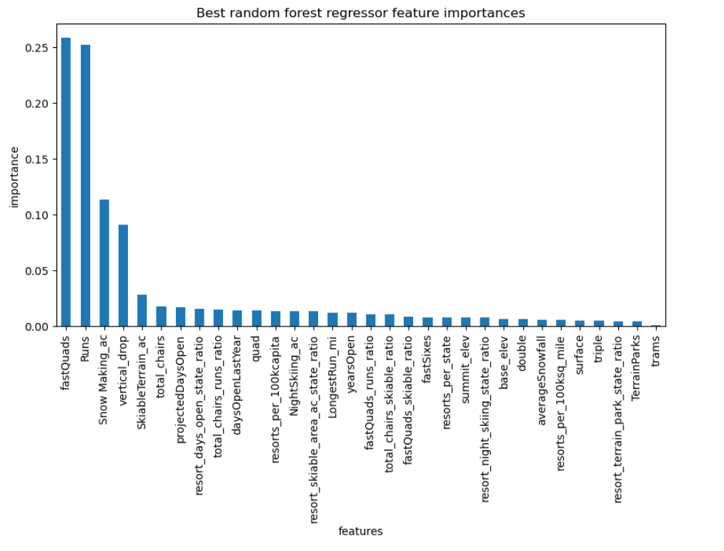
After running the random forest model on our training data this graph was created which shows how much impact each feature has on the ticket price.

Slide 9
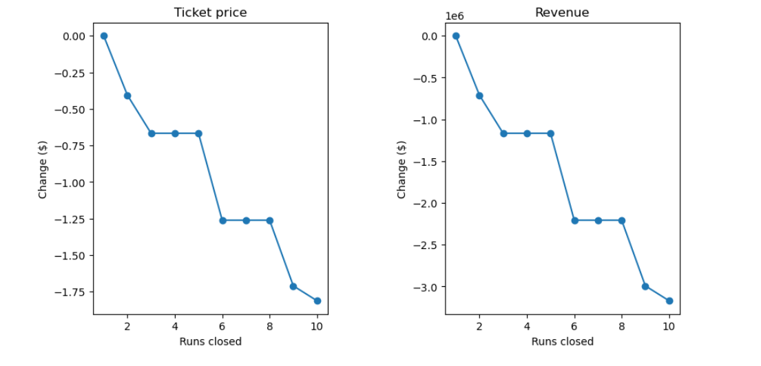
This graph was created to show the impact that closing runs would have on Big Mountain. Key finding here were that closing a single run does not have an impact on the recommended price that Big Mountain can charge for tickets and that closing five runs does not have any additional impact beyond closing three runs would.

Slide 10
This graph was created to show the impact that closing runs would have on Big Mountain. Key finding here were that closing a single run does not have an impact on the recommended price that Big Mountain can charge for tickets and that closing five runs does not have any additional impact beyond closing three runs would.

Slide 11
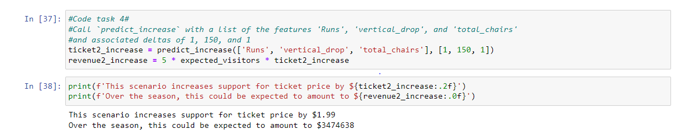
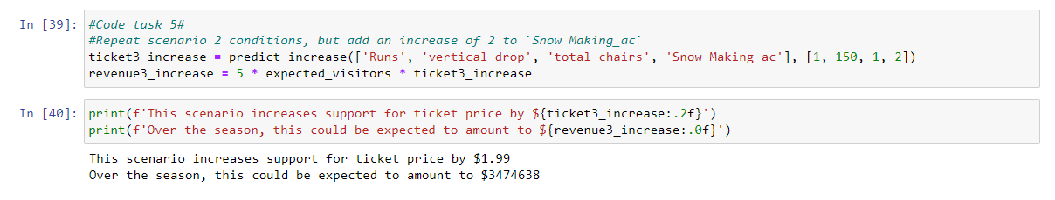
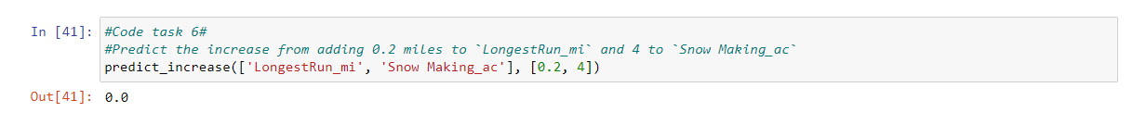
These are the results from scenarios where runs were added, vertical drop was increased, total number of chairs was increased, snow making area was increased, and the longest run was increased. The results of each can be found in their blocks of code.

Slide 12
SUMMARY
Based on the findings provided, the recommendation is to focus on one of the two key areas below:
Reduce maintenance costs and maximize profit by closing a single run or closing five runs.
Enhance the park with new features (runs, vertical drop, and/or chairs) that allow Big Mountain to charge more per ticket thereby increasing revenue and increasing profit.

